Slide 1
Hamster Capstone Initial Testing Results🐭
by: Jared Hemauer, Rylee Horney, Keenan Keams, Joseph Lopez

Slide 2
Customer Requirements
CR 1. Size – the client wants the device to be small enough that it is portable and can move over the surface of a desk.
CR 2. Speed – the device will need to be able to reach a speed of up to 1 m/s in any direction. This is to allow for the device to keep up with a patient’s hand speed.
CR 3. Force – must be able to produce a force of up to 10 N to the patient’s hand in any direction or 5 Nm of torque about the vertical axis.
CR 4. Internal Friction – when motors are not being used the device must be able to be moved with less than 5N of force.
CR 5. Backlash- when motors are off the device must not move more than 0.1mm.
CR 6. Run Time – the device must run for at least 30 minutes on a single charge.
CR 7. Interface: device must be able to receive commands from a computer and send its position back to the computer in (x, y) coordinates.
CR 8. Screen – there must be a touch screen that is at least four inches on the device.
CR 9. Cost – total production of the device must be <$500.
CR 10. Microcontroller – client prefers Raspberry Pi to be used due to faster processing speeds.
CR 11. Ease of Use – should not require more than a number for the force being applied and a direction.
CR 12. Comfortable – the device should be comfortable in a patient’s hand.

Slide 3
Engineering Requirements
ER1- Motor Torque (Nm) – the motor must be able to produce enough torque to output a force of 10N on the patient’s hand.
ER2- Battery Life (kW hr ) – needs to last at least 30 minutes under load.
ER3- Battery Amperage (A) - need to be able to produce enough current for all components in the robot at least 6 Ah (i.e. three motors, raspberry pi, sensors, motor controller, and screen)
ER4- Size (ft) – less than 1ftx1ftx1ft
ER5- CPU Speed (s) – the microcontroller needs to be able to send commands quickly so there is minimal delay in the movement of the robot. (16 MHz)
ER6- Weight (lb.) - less than 10lbs

Slide 4
Testing Summary
Experiment/ Test ​ | Relevant Design Requirements ​
EX 1: Prony Brake ​ | CR 2, CR 3, ER 1 ​
EX 2: Force Output Test ​ | CR 3, CR 4 ​
EX 3: Duration Test ​ | CR 6, ER 2, ER 3 ​
EX 4: Position Test ​ | CR 5, CR 7 ​

Slide 5
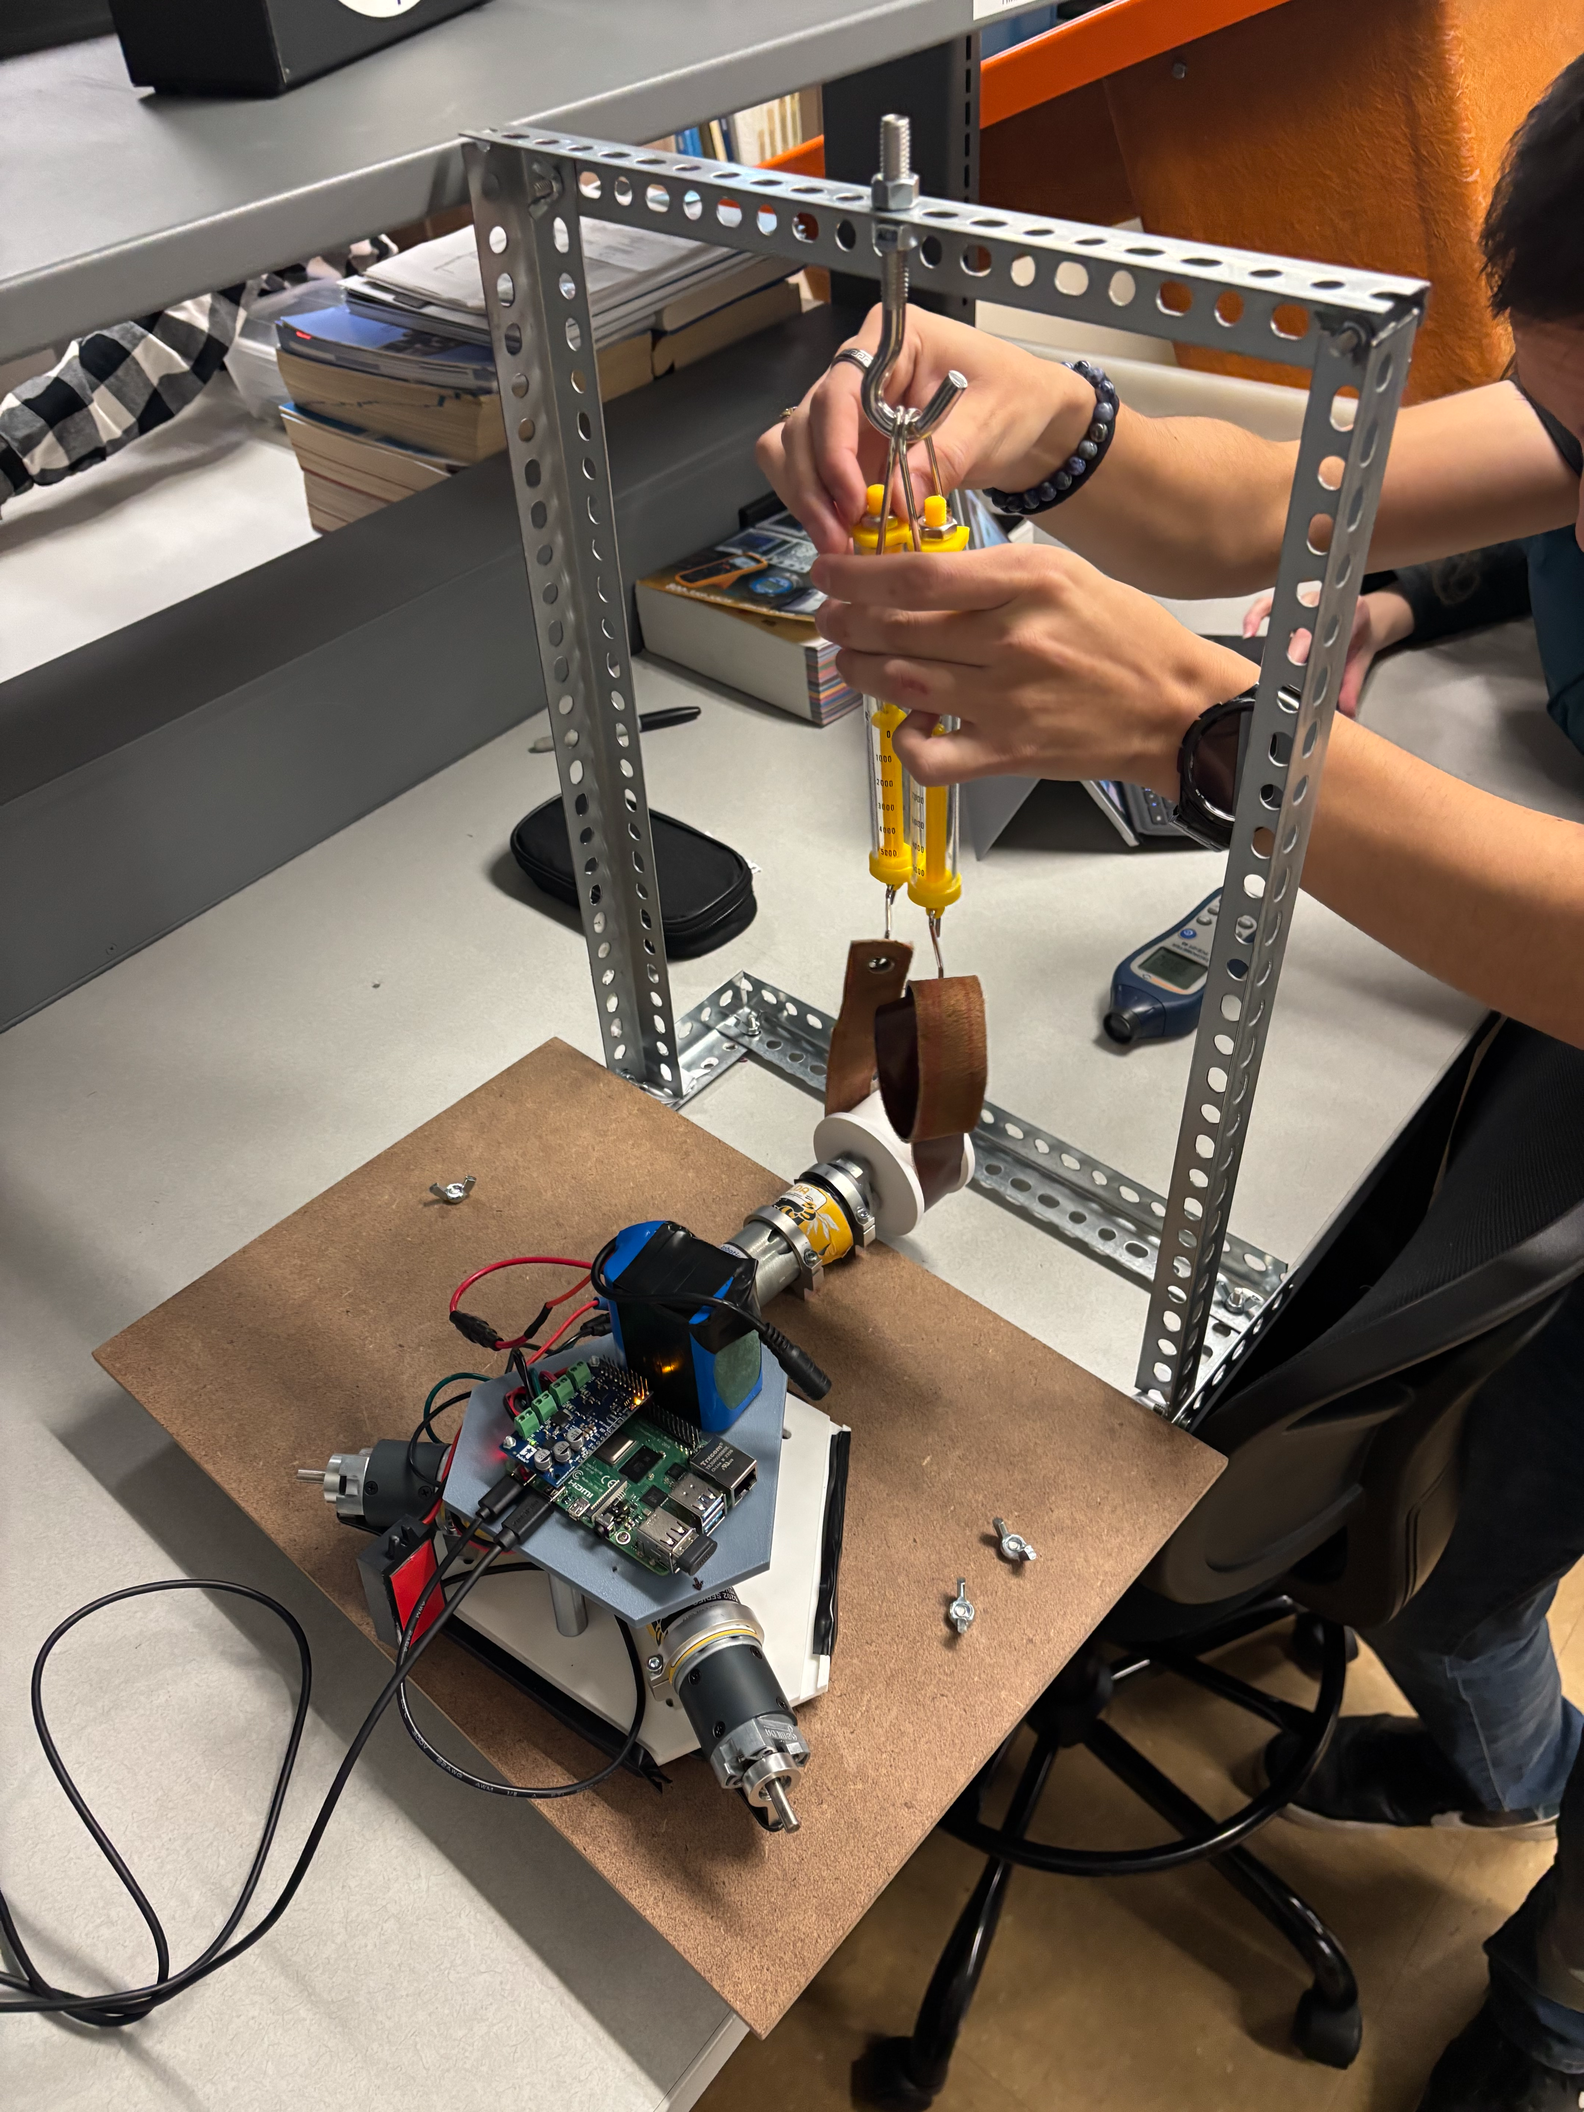
Prony Brake
The goal of this experiment is to find the torque speed curve of the motors.
With the torque speed curve, the Motor Torque constant (K) will be found.
Affects how much current is being sent to the motors.

Slide 6
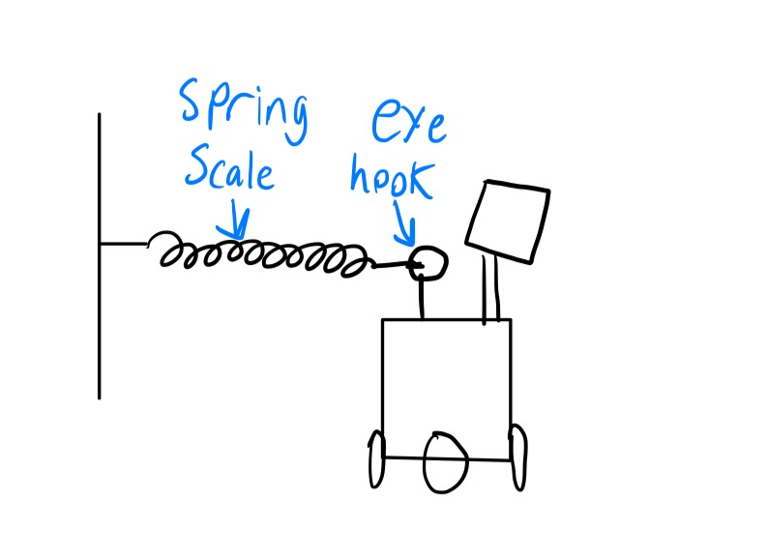
Force Output Test
Will determine if the robot can generate 10N of force
Verify that a patient can move the robot with 5 N of force when turned off
The equipment used will be a spring scale attached to the robot using an eye hook.

Slide 7
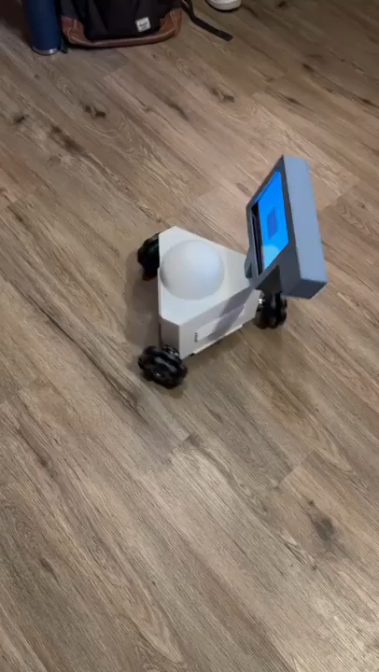
Duration Test
The robot was set to run for consistently for the duration of test.
Desired time while running was 30 minutes.
The battery showed no signs of being close to empty and lasted much longer for future tests

Slide 8
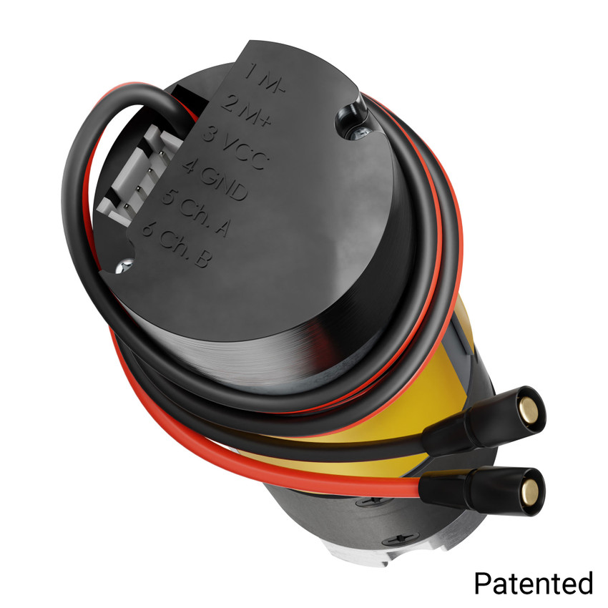
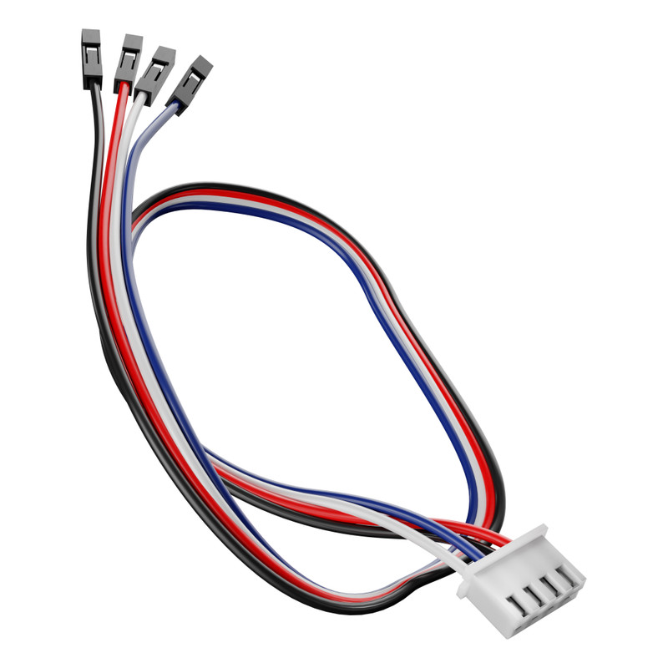
Position Test
By connecting the encoder cables to the motor the change in rotation for each of the shafts can be found using code.
By using that data and adding much more lines of code the total change in distance can be found.
To verify the results the team will measure the change in X, Y, and the change in orientation from the point of origin.

Slide 9
Customer Requirements Met
Customer Requirement | CR Met? (Y or N) | Client Acceptable (Y or N)
CR 1- Size | Y
CR 2- Speed | Y
CR 3- Force
CR4- Internal Friction | Y
CR 5- Backlash | N
CR 6- Run Time | Y
CR 7- Interface
CR 8- Screen | Y
CR 9- Cost | Y
CR 10- Microcontroller | Y
CR 11- Ease of Use | Y
CR 12- Comfortable | Y

Slide 10
Engineering Requirements Met
Engineering Requirement | Target | Tolerance | Measured/ Calculated Value | ER met? (Y or N) | Client Acceptable (Y or N)
ER 1- Motor Torque | 0.42 Nm | +/- 0.05 Nm | 2.4 Nm | Y
ER 2- Battery Life | 30 mins | +/- 5% of target | >30 mins | Y
ER 3- Battery Amperage | 6 Ah | +/- 5% | 6 Ah | Y
ER 4- Size | < 12in³ | +/- 2” for all | ~11in³ | Y
ER 5- CPU Speed | 16MHz | +/- 5% of target | 1.5 GHz | Y
ER 6- Weight | <10lbs | +/- 1 lb. | 10.7 lbs | Y

Slide 11
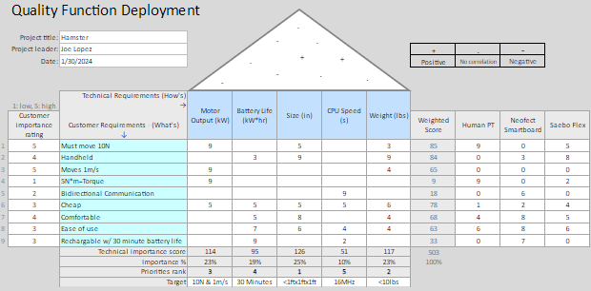
QFD

Slide 12
Thank you

